Slide 1
Car price prediction

Slide 2
Introduction:
The price of a brand-new car in the industry is fixed by the manufacturer with some additional costs incurred by the Government in the form of taxes. So, customers buying a new car can be assured of the money they invest to be worthy. But, due to the increased prices of new cars and the financial incapability of the customers to buy them, Used Car sales are on a global increase. Therefore, there is an urgent need for a Used Car Price Prediction system which effectively determines the worthiness of the car using a variety of features. Existing System includes a process where a seller decides a price randomly and buyer has no idea about the car and its value in the present-day scenario. In fact, seller also has no idea about the car’s existing value or the price he should be selling the car at. To overcome this problem, we have developed a model which will be highly effective. Regression Algorithms are used because they provide us with continuous value as an output and not a categorized value. Because of which it will be possible to predict the actual price a car rather than the price range of a car.

Slide 3
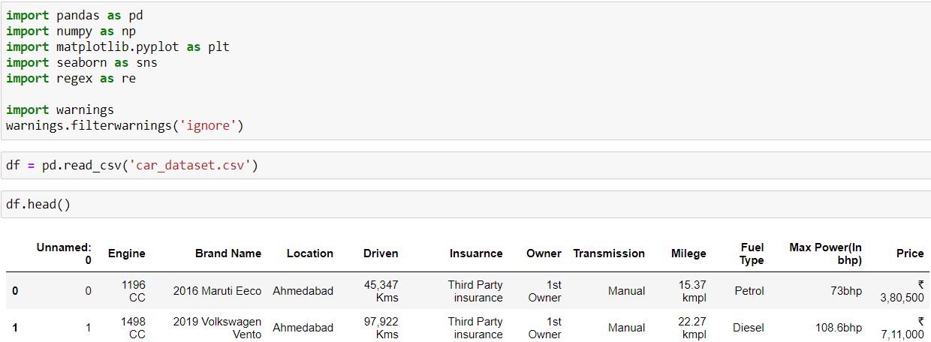
EDA
Exploratory Data Analysis or EDA is process of analyzing data. It is an important process and step in data science project in which we clean the data, removing the redundant from the dataset, finding patterns and anomalies in the dataset.
Understanding Variables:
Understanding your data is so important let’s see how you can do it in practice. First, we need to import basic libraries and dataset.

Slide 4
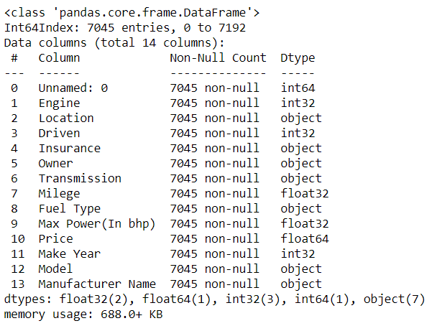
Checking dataset
Checking basic info like null values, basic statistics, shape and unique values present in each columns

Slide 5
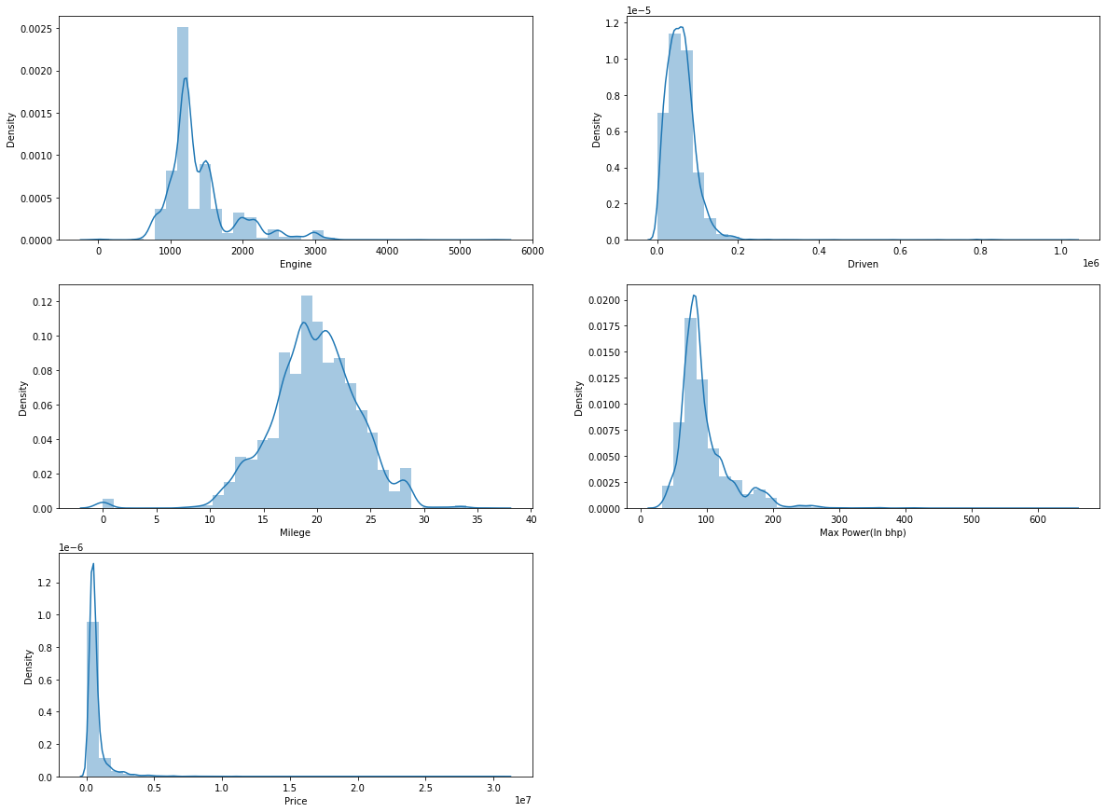
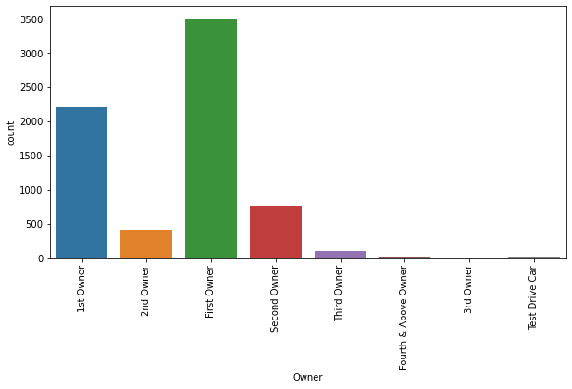
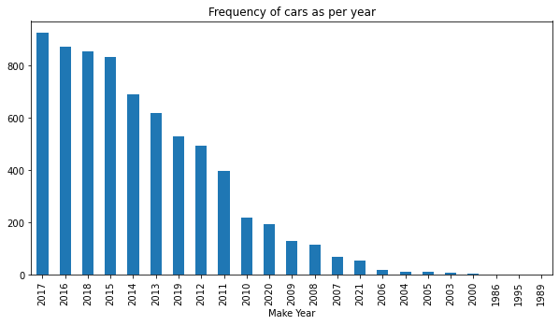
Univariate Analysis:
Here in dataset we have both numerical as well as categorical data
Here we have seen the distribution of each columns and no. of categories present in each column. By this we can check whether a continuous column is skewed or not.

Slide 6
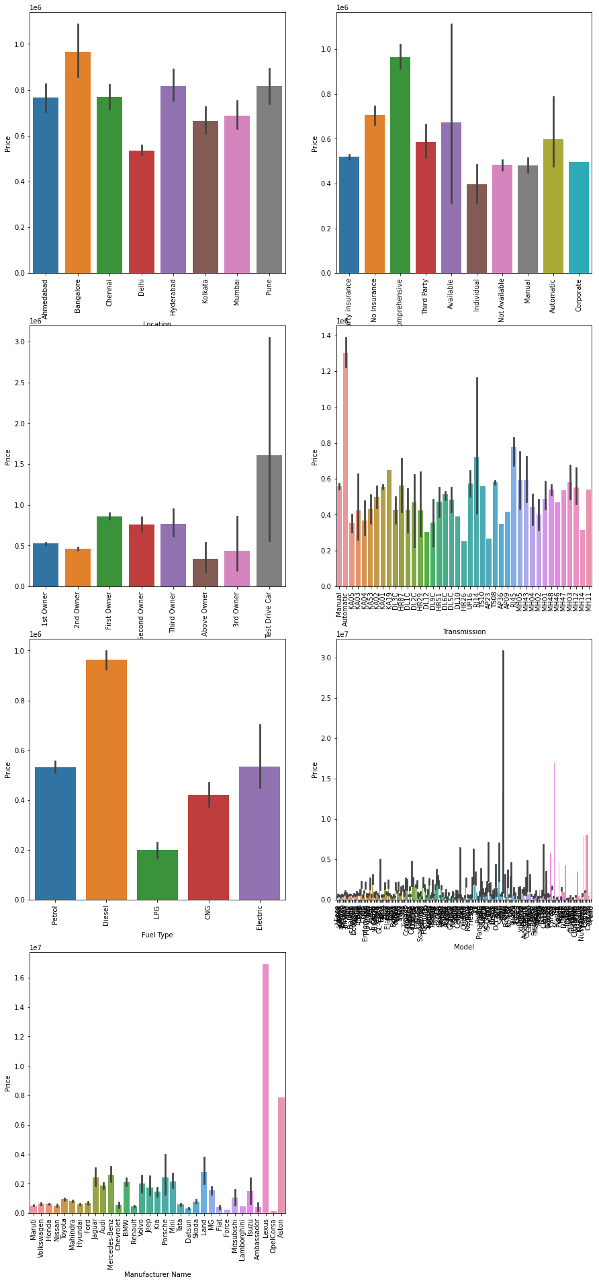
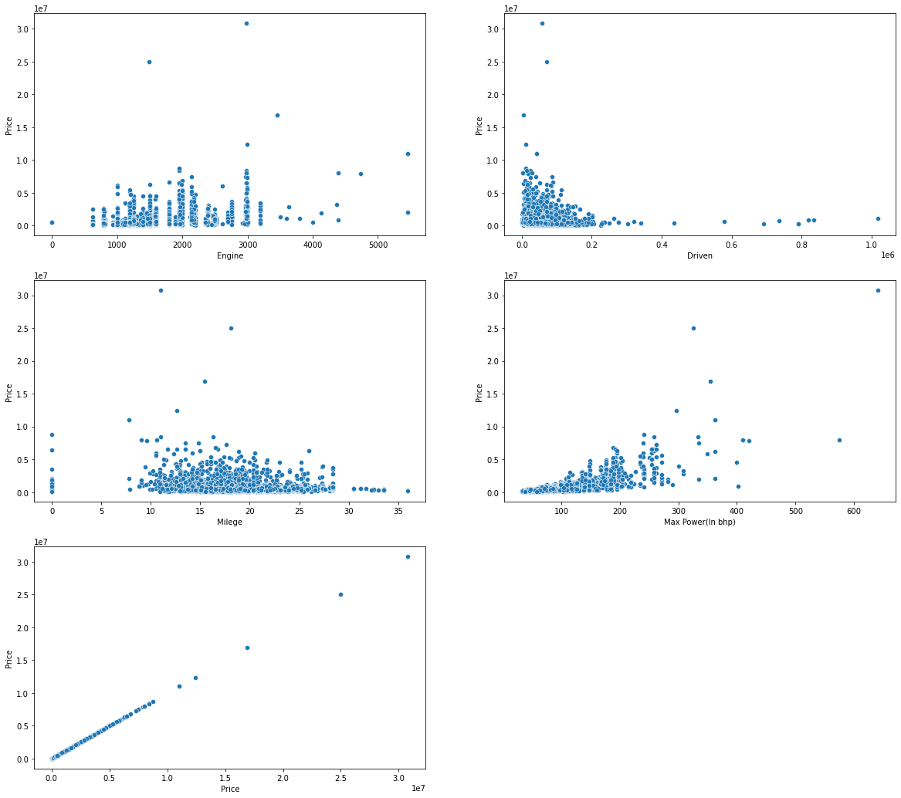
Bivariate Analysis:
Bivariate analysis is the best method to check whether any features is related to target variable or not.

Slide 7
Observation in bivariate analysis:
Used car price is high in Bangalore. whereas Delhi car has lowest Price as compare to other location.
The car which have comprehensive insurance has a slightly higher price than other car which have third party or other type of insurance.
The Diesel Model of a car have high price comparatively any other car which use different fuel type.
The Lexus and auton brand car have slighlty high price as compare to other brand and Maruti and Force comes under Budget cars.

Slide 8
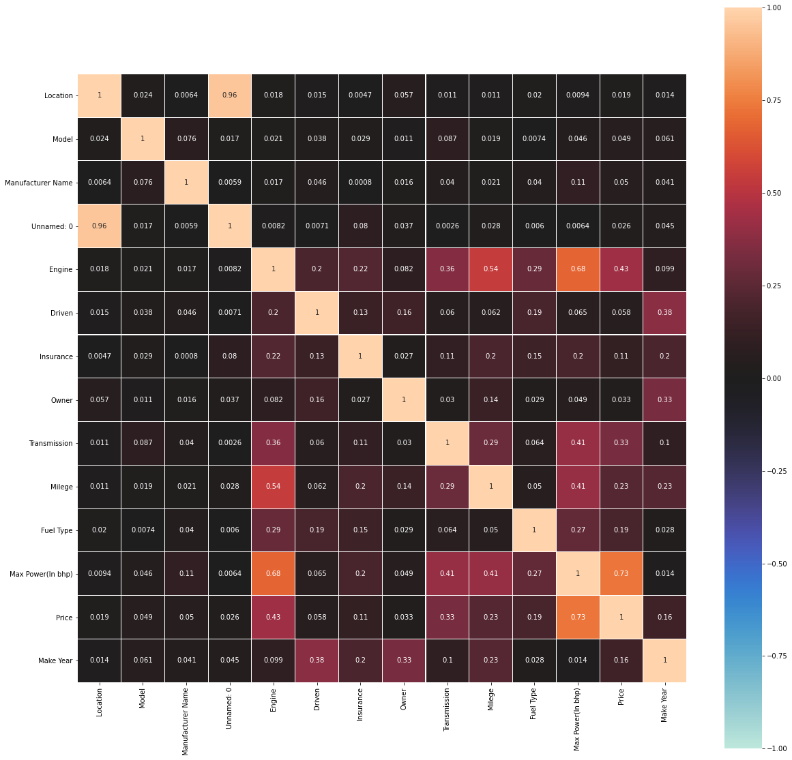
Multivariate Analysis
From this heatmap we can see that only Max Power(In bhp) has the good correlation with the variable.

Slide 9
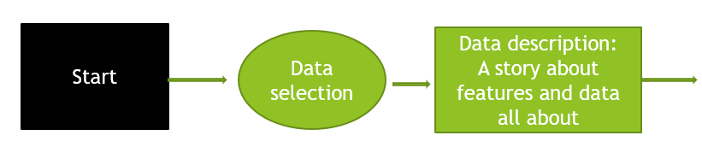
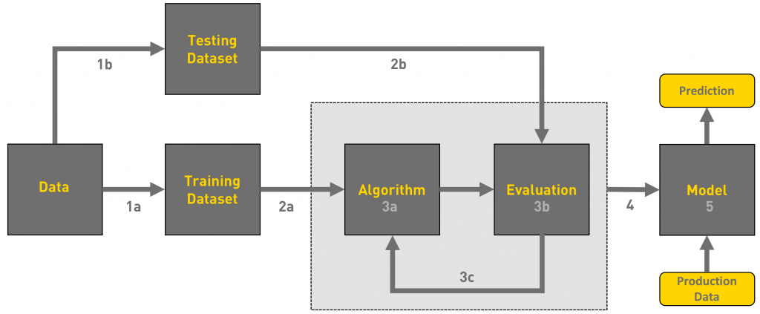
Model Building
Data transformation

Slide 10
Conclusion
The increased prices of new cars and the financial incapability of the customers to buy them, Used Car sales are on a global increase. Therefore, there is an urgent need for a Used Car Price Prediction system which effectively determines the worthiness of the car using a variety of features. The proposed system will help to determine the accurate price of used car price prediction. This report compares 5 different algorithms for machine learning : Bagging Regressor, Gradient Regressor, RandomForest Regressor, XGBRegressor and AdaBoostRegressor.

